Slide 1
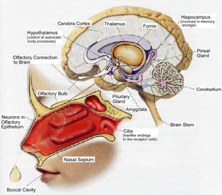

Olfactory processing of odor objects
Joël Sandé

Slide 2
Outline
Introduction
Evolution of olfactive receptor
Effect of concentration
Architecture of olfactory bulbe
Signaling pathway
Olfactory cortex
Puriform cortex (some features)
Paper : Bio-hybrid sensory system
Brain signal images
State of the art
Conclusion
Question

Slide 3

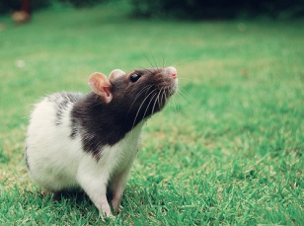
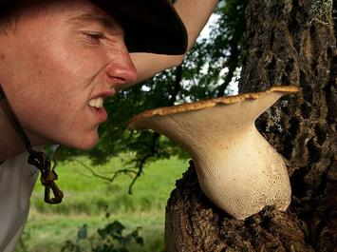


Introduction
The sense of smell allows terrestrial organisms to detect and distinguish a large number of volatile substances in the environment
Essential for the survival of any living being
edibility of food
potential hasard
Body odour
Reconnaissance of the environment
Food acceptation

Slide 4
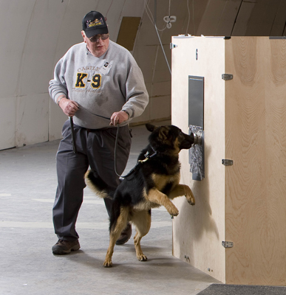

Able to distinguish 1000 of different odorants
Introduction
Although considered less efficient compared to other mammals such as dog and rat

Slide 5
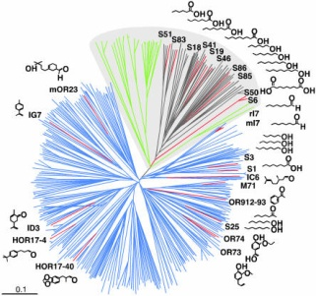
Evolution of olfactive receptors
2 groups of OR :
First group includes the OR
related to those of Fish
(class I). green
Second group contains
only OR air present in
Animals (class II). red
Phylogenetic tree of sequence relationships among Ors

Slide 6
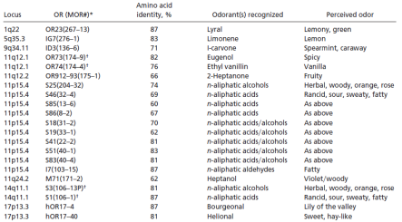
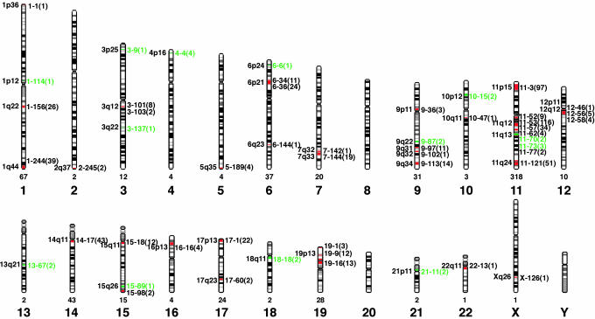
Evolution of olfactive receptors
630 human OR genes located on 21 different chromosomes. The only chromosomes that do not seem to contain OR genes are chromosomes 8, 20 and the Y chromosome.
Researchers have been able to determine the odorant recognition for a bunch of locus

Slide 7
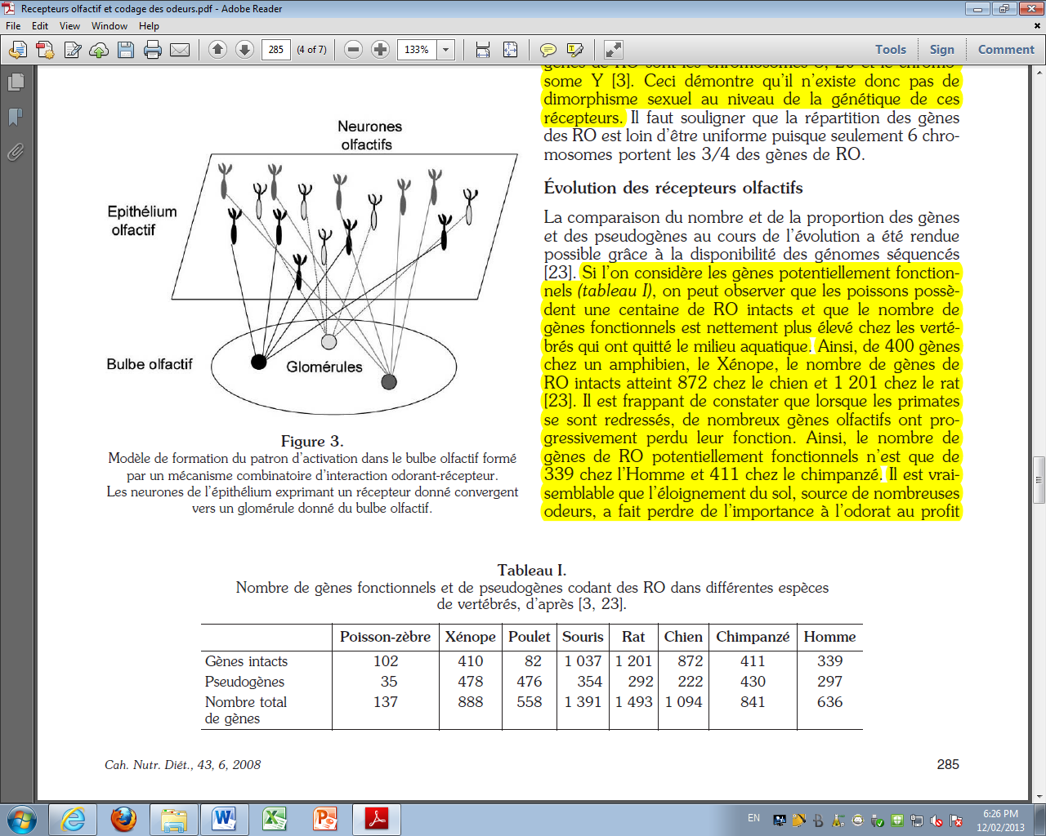
Evolution of olfactive receptors
Functional genes
Remark: When primates raised, many olfactory genes have gradually lost their function. It is likely the distance from the ground, the source of many odors, has lost importance to smell the benefit of the vision.

Slide 8
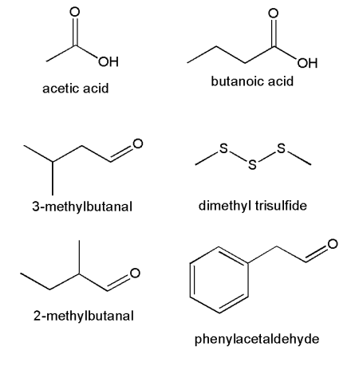
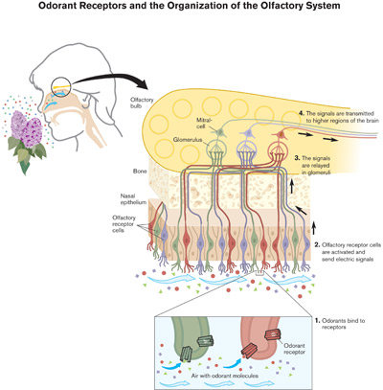
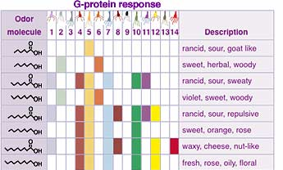
Olfactory sensory
Binding of odorant molecules to specialized receptors
This interaction Triggers complex cellular reaction cascades -> transduction of chemical signals into a pattern of electrical activity conveyed to the brain for further processing

Slide 9
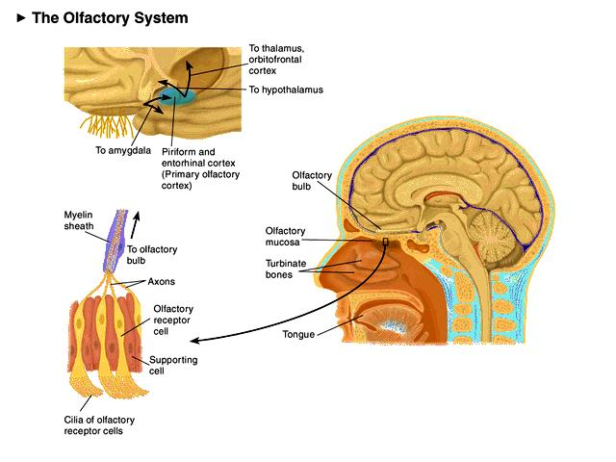
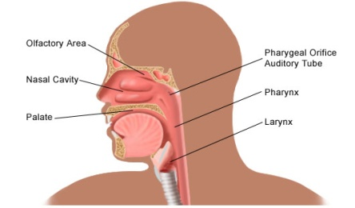
Olfactory sensory
small molecules - hydrophobic character – volatile - top of the nasal cavity
In each nasal cavity, around 6 million neurons projecting into 1 of the 2 olfactory bulbs through dendrites
http://www.youtube.com/watch?v=dIDBG-UPRUI

Slide 10
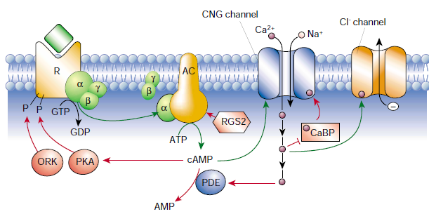
Olfactory receptor
Stuart Firestein, 2001
Neurons can follow repeated odor pulses at frequencies of up to 10 Hz odour must be rapidly inactived
Prerequisite for high sensitivity

Slide 11
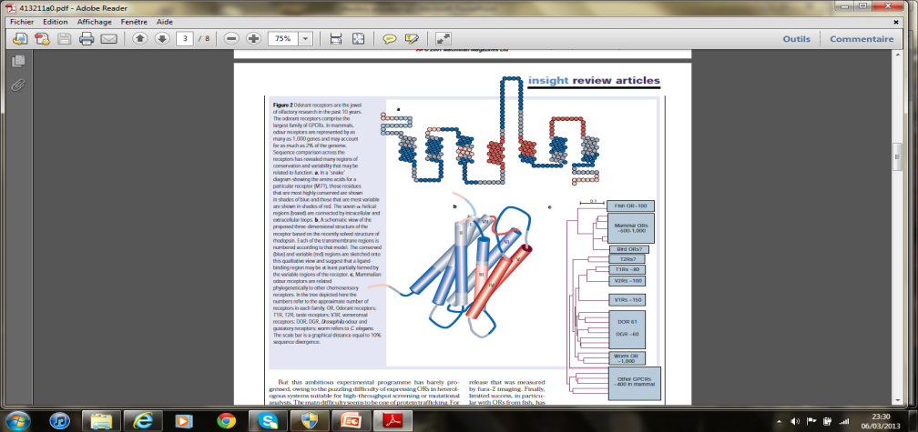
Olfactory receptor
RO are equipped with:
7 transmembrane domains connected by 3 external loops, 3 cytoplasmic loops. The RO consists of 300 to 350 amino acids.
Oriented face extracellular binding site that corresponds to regions hypervariables sequences located in the helices transmembrane III to VI

Slide 12
Olfactory receptor
Qst : Is there a limited number of receiver that proceed by combining or an unlimited number of receivers each specific odor ?
Findings suggest that the mammalian olfactory system uses a combinatorial coding system to discriminate between odors.

Slide 13
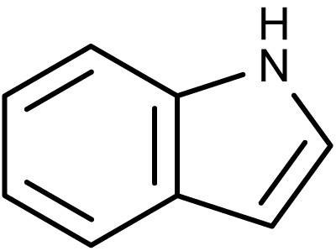
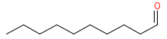
Effect of concentration
the same molecule can have pure olfactory notes differ depending on the concentration
fecal indole Jasmine
candle Decanal lemon
notion of odotope: different affinity with 2 receptors.
high
low
high
low

Slide 14
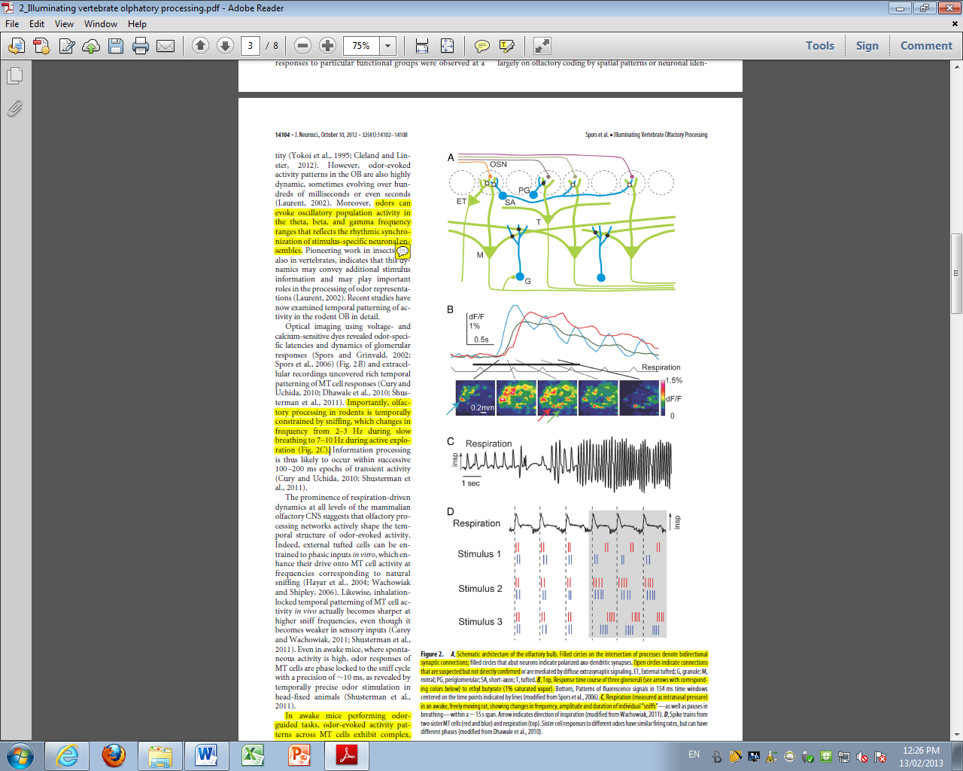
Architecture of olfactory bulb
A
Filled circles denote
bidirectional synaptic connections
Open circles
ET = External tufted; G = granule ;
M = mitral; PG = periglomerular;
SA = short-axon; T = tufted.
B Response time course of 3
glomeruli to ethyl butyrate.
C Respiration measured in an awake, freely moving rat, showing changes in frequency, amplitude and duration of individual “sniffs”

Slide 15
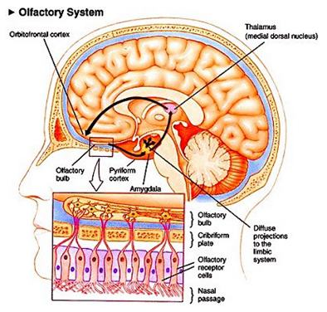
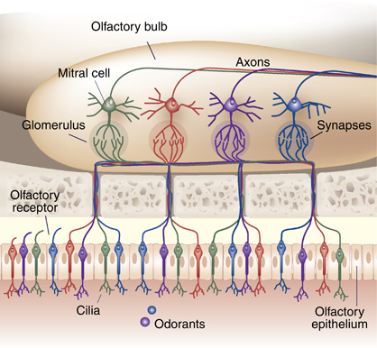
Signaling pathway
In vertebrae these input pattern are processed in the olfactory bulb.
Output of OB is conveyed to cortical and subcortical areas

Slide 16

Signaling pathway
The activity of neurons in higher brain areas is not only modulated by odors but also by variable behaviors
versus
Converging projection + Diverging projections producing parallel processing to different sub-regions of the OC thus OC play a crucial role in the translation into emotional and memory perception.

Slide 17
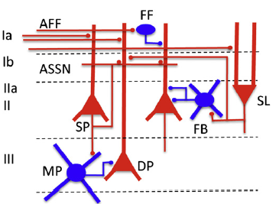
Olfactory cortex
OC consists in 3 layers
plexiform layer
Body cell layer
Layer of Bodies cell of Deeper pyramidal
The Piriform cortex is the largest sub-region of olfactory cortex

Slide 18
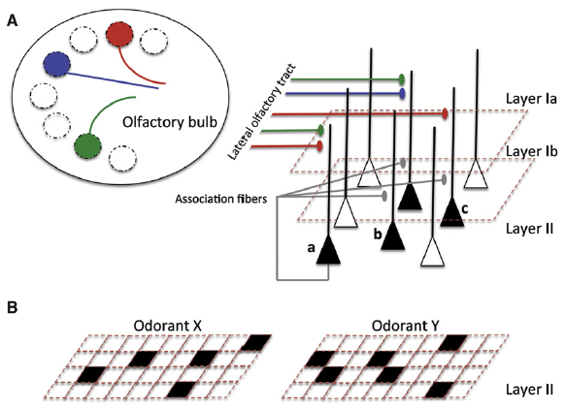
Puriform cortex
Features
Piriform cortex performs pattern separation and completion
Pyramidal cells that do not respond directly to stimulation of individual glomeruli, do respond when specific combinations of glomeruli are activated
Auto associative connection

Slide 19
Puriform cortex
Piriform cortex is susceptible to run-away excitation and seizure activity Thus, synaptic inhibition plays the role of managing the sensitivity of the circuit.
Distributed Afferent Input
Evoked Ensemble Activity
Associative Synaptic Plasticity
Neuromodulation

Slide 20
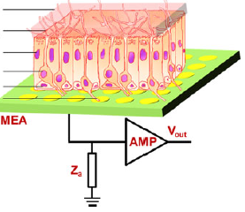
Bio-hybrid sensing system
Purpose : combine olfactory epithelium
with microelectrode array (MEA) to
establish an hybrid system to record the
odor-induced electrophysiological activities of the tissue
Method : They measured extracellular potential of olfactory receptor neurons in intact epithelium in the presence of ethyl ether, acetic acid, butanedione, and acetone, respectively

Slide 21
Bio-hybrid sensing system
Fabrication of microelectrode array
MAE is widely applied to detect tissue electro-physiological signals
Layer of Ti (30 nm) was deposited onto the glass substrate for 30 min
The photoresist was spin-coated onto the metallic layer
The metal without protection was removed, while the electrodes and interconnections were left

Slide 22
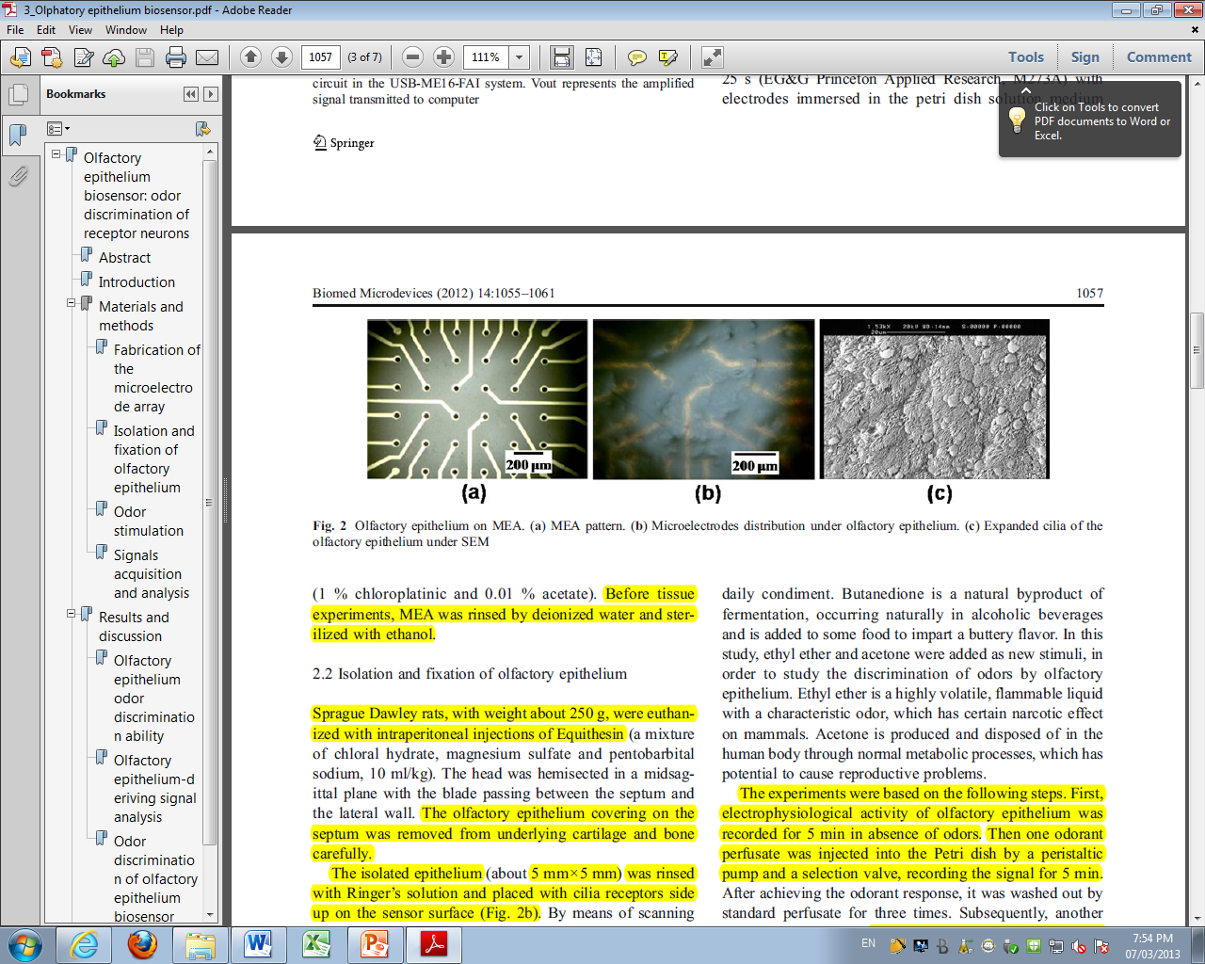
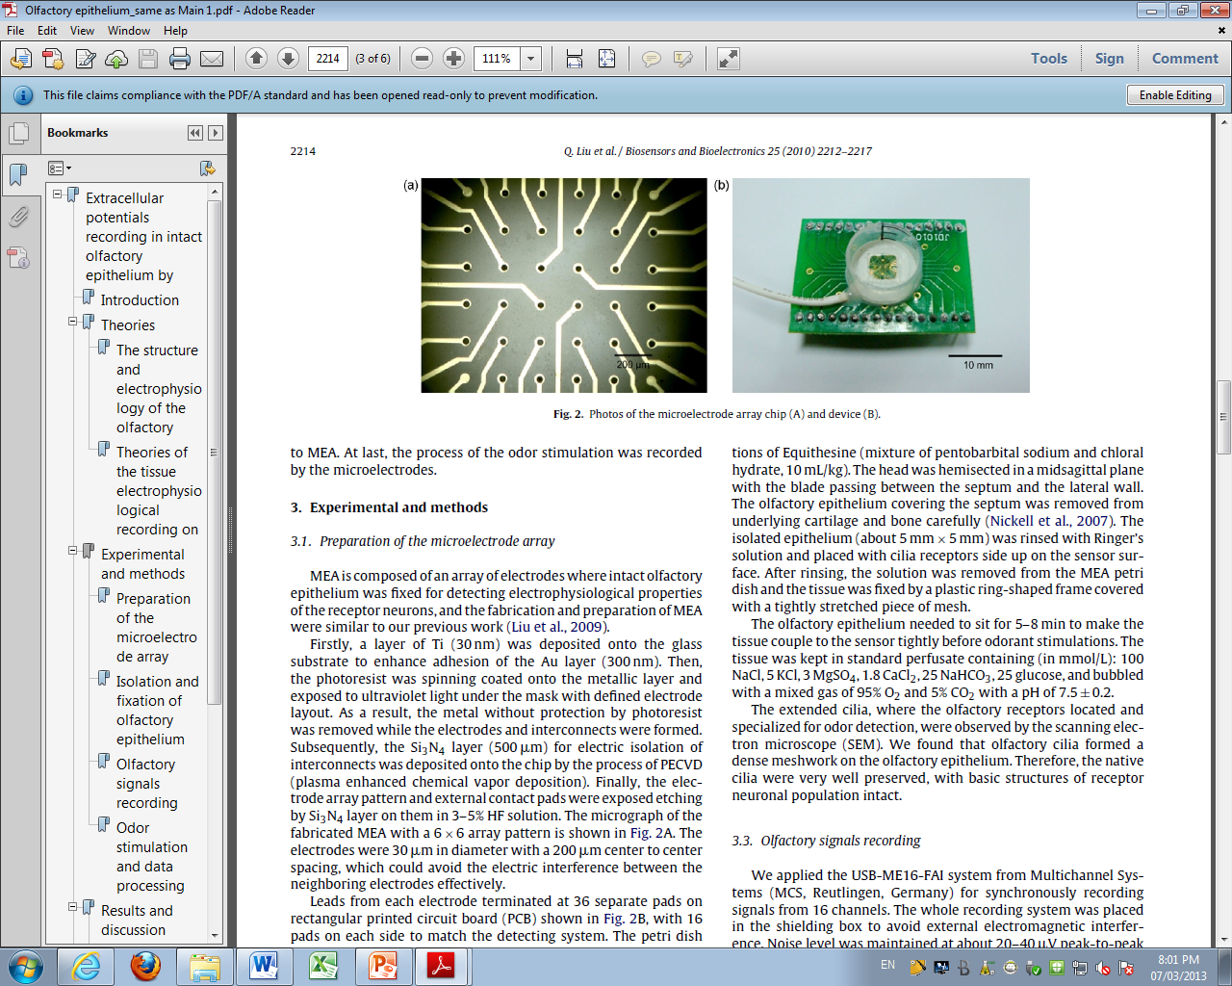
Bio-hybrid sensing system
Micrograph of MEA with a 6×6 array
(a) MEA pattern
(b) Microelectrodes distribution under olfactory epithelium
(c) Expanded cilia of the olfactory epithelium under SEM

Slide 23
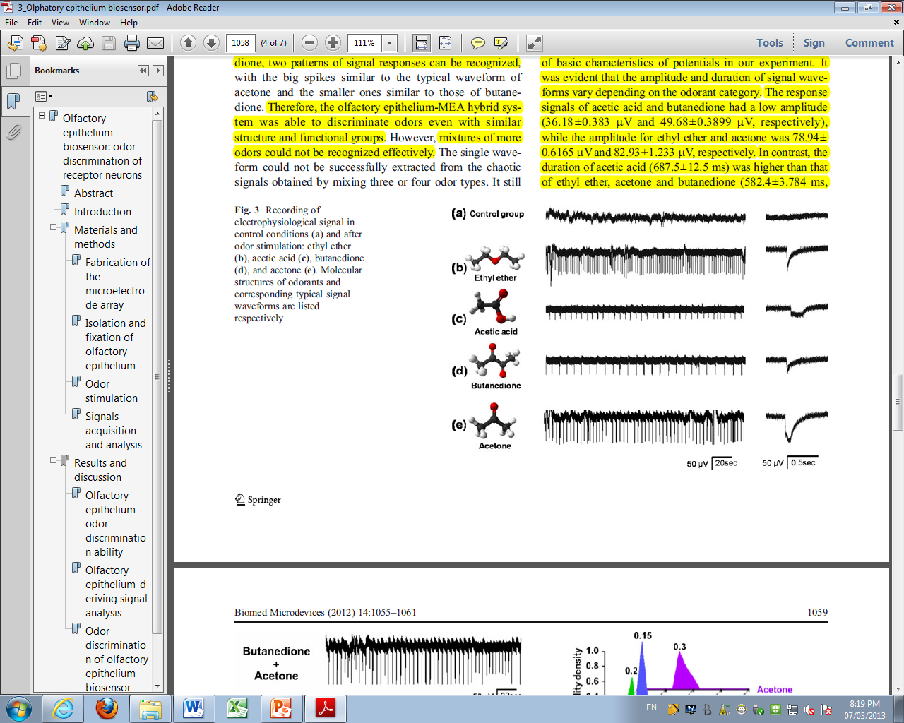
Bio-hybrid sensing system
Results
Compared to the control group, signals after odor induced stimulation show evident evoked potentials, with difference in firing rate and amplitude.

Slide 24
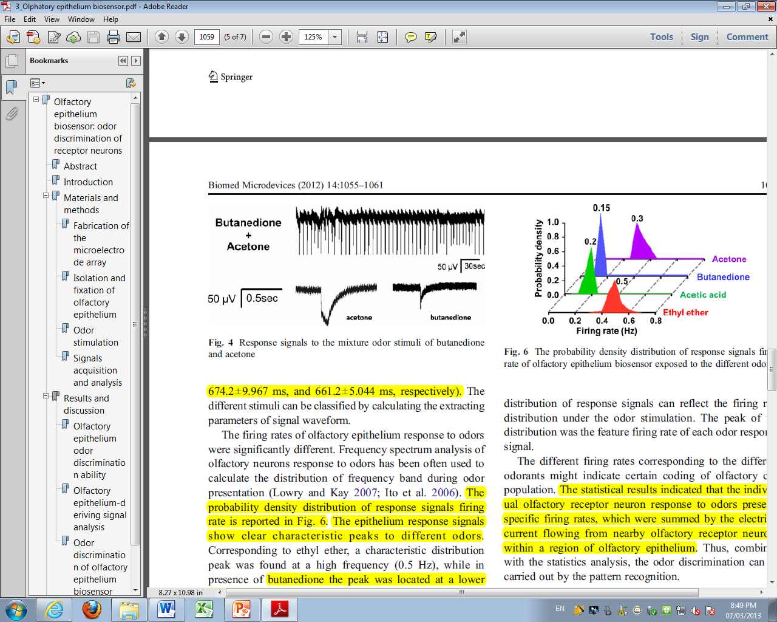
Bio-hybrid sensing system
Results
(personally I see only Acetone)
Response signals to the mixture odor stimuli
mixture of acetone and butanedione. Although there is a similar functional group of –C=O in acetone and butanedione, 2 patterns of signal responses can be recognized – able to discriminate

Slide 25
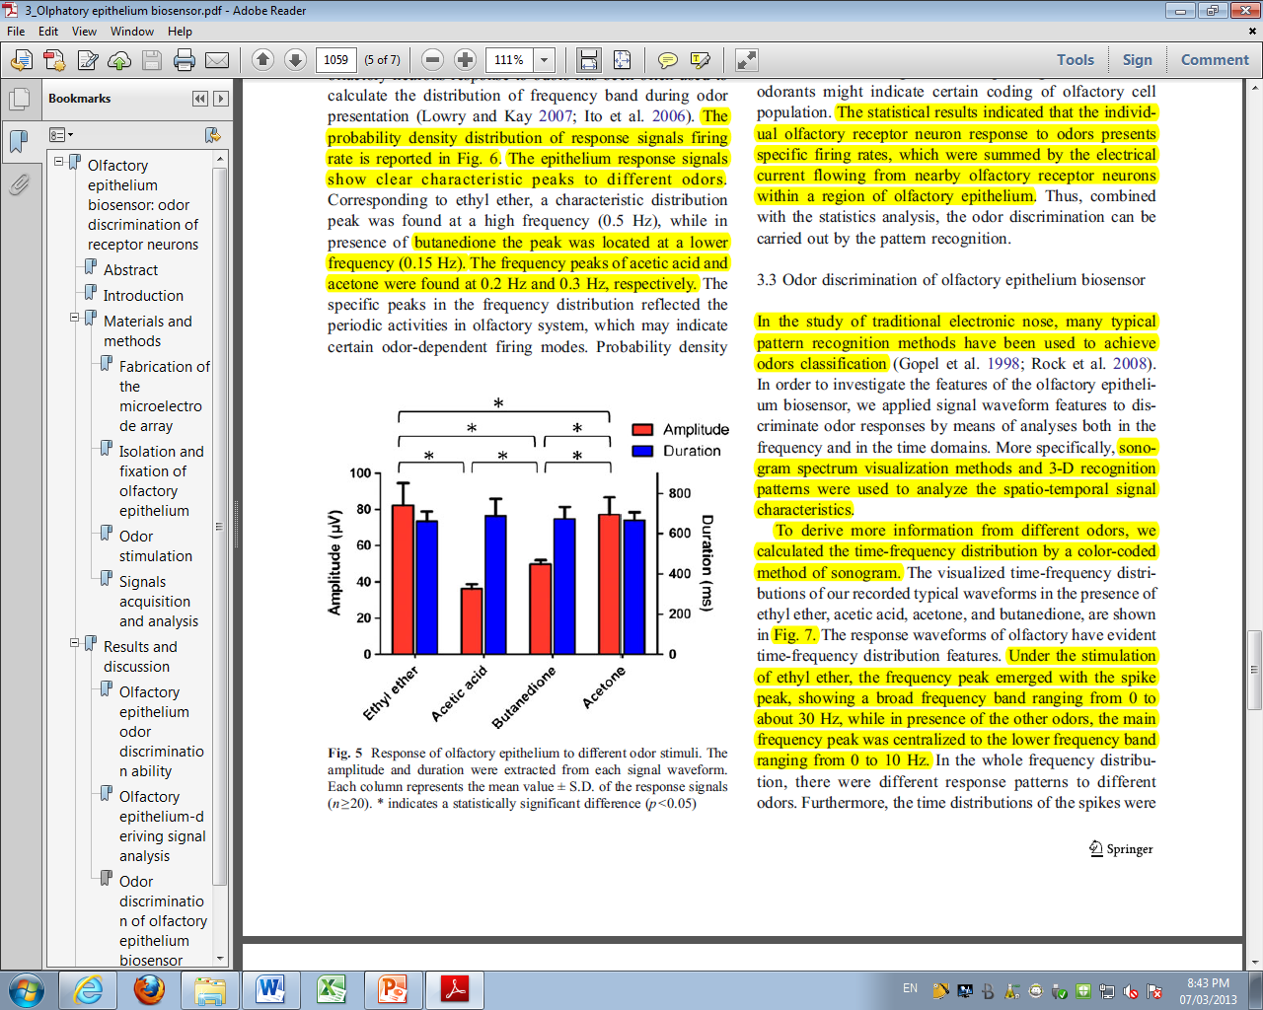
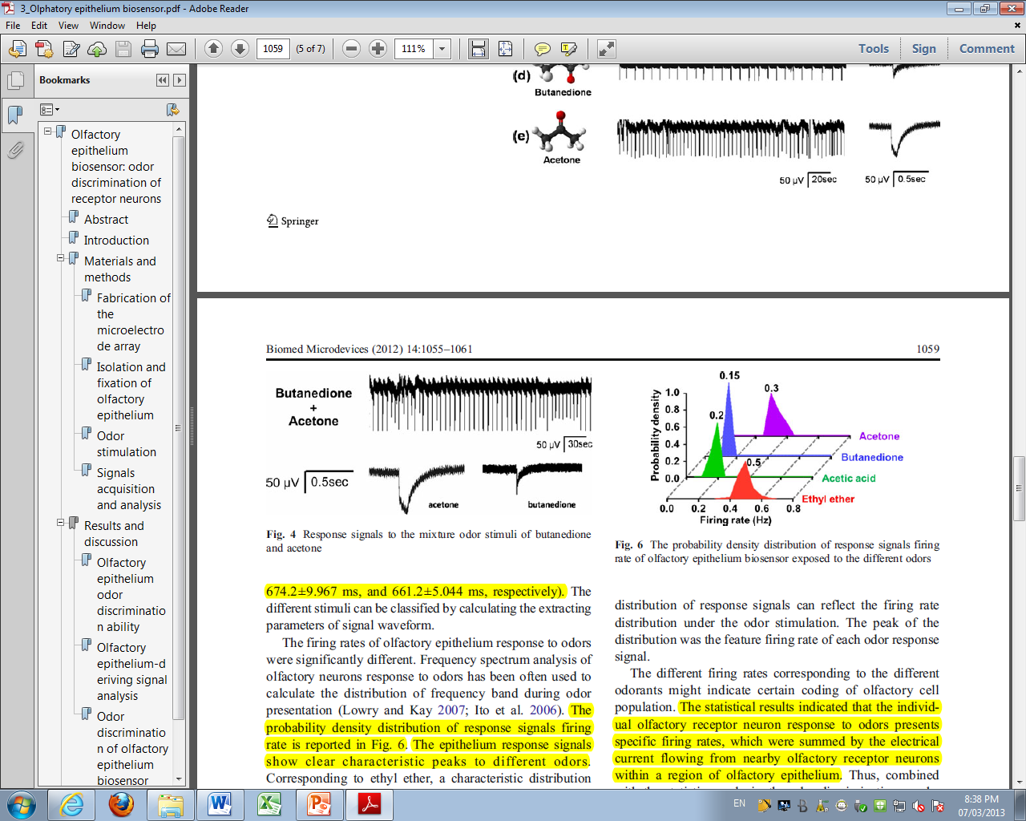
Bio-hybrid sensing system
Signal waveforms are characterised by: amplitude - duration - firing rate
Normalized result of basic characteristics of potentials in our experiment. It was evident that the amplitude and duration of signal waveforms vary depending on the odorant category
No correlation

Slide 26
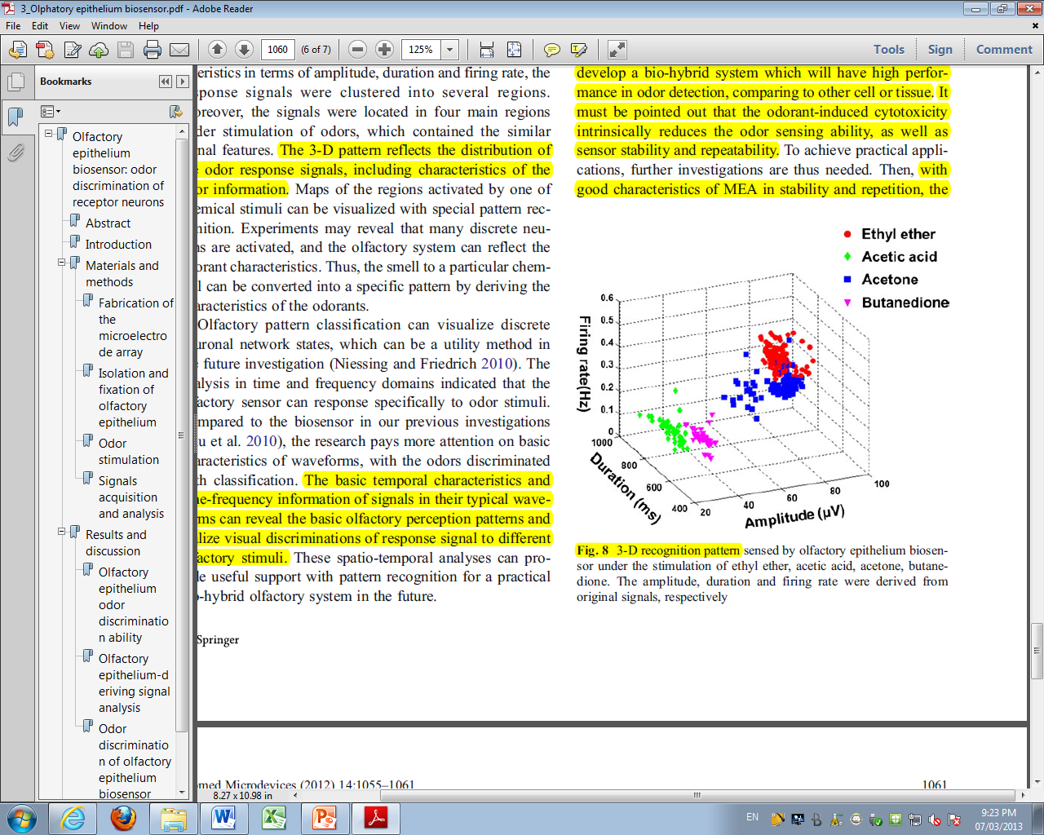
Bio-hybrid sensing system
All the characteristics can be extracted to analyse the discrimination in 3D recognition pattern

Slide 27
Bio-hybrid sensing system
Conclusion: The bio-hybrid system can reflect the in vitro odor information of different signal characteristics. It provides a reliable and fast platform to odor detection.

Slide 28
Brain signal images
Analyse of brain activity
Manganese-enhanced MRI. 4 features :
Mn has paramagnetic properties that make it detectable by MRI.
Mn is a calcium analogue and, as such, is taken up by activated neurons and migrates along neuronal processes .
Mn is slowly eliminated by neurons.
MEMRI allows to avoid both anesthesia and restraint during stimulation.

Slide 29
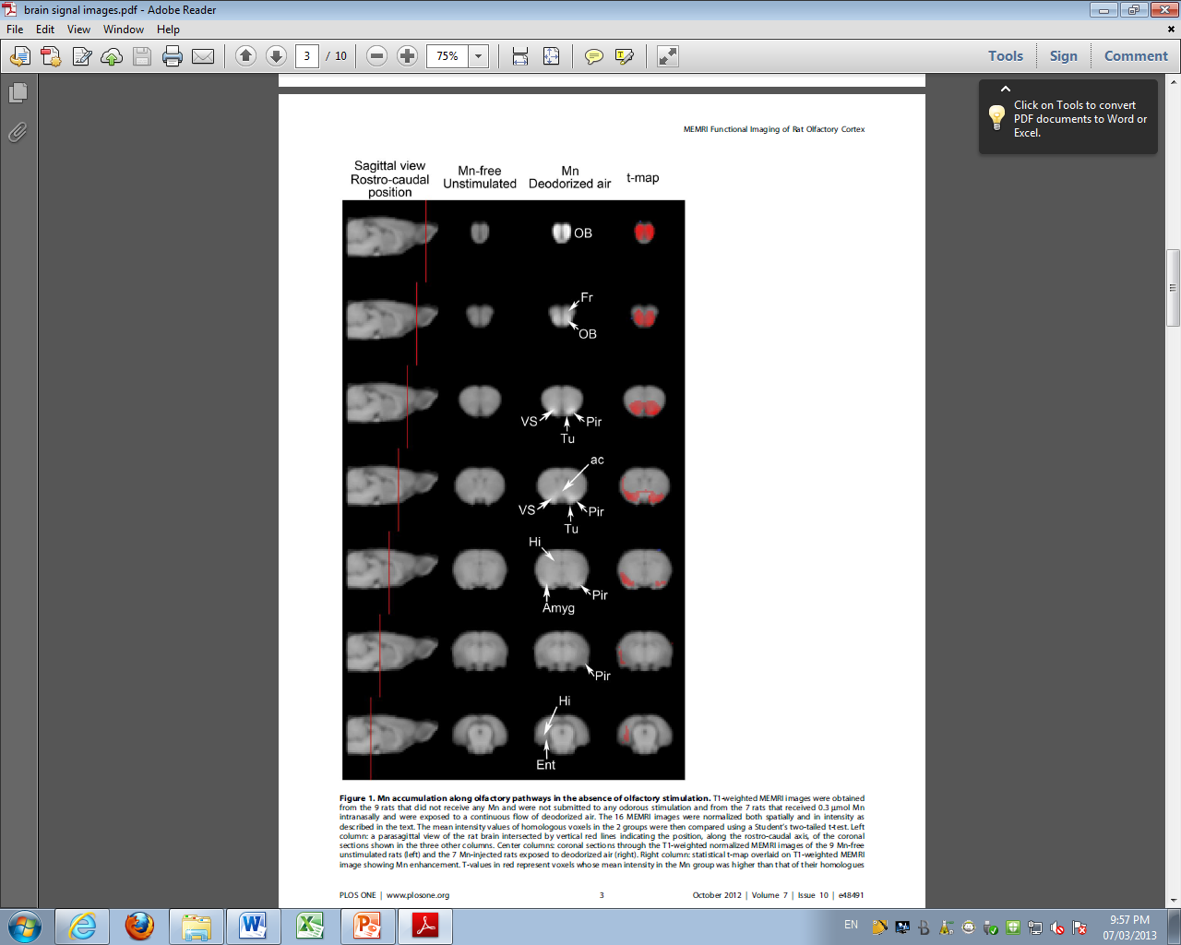
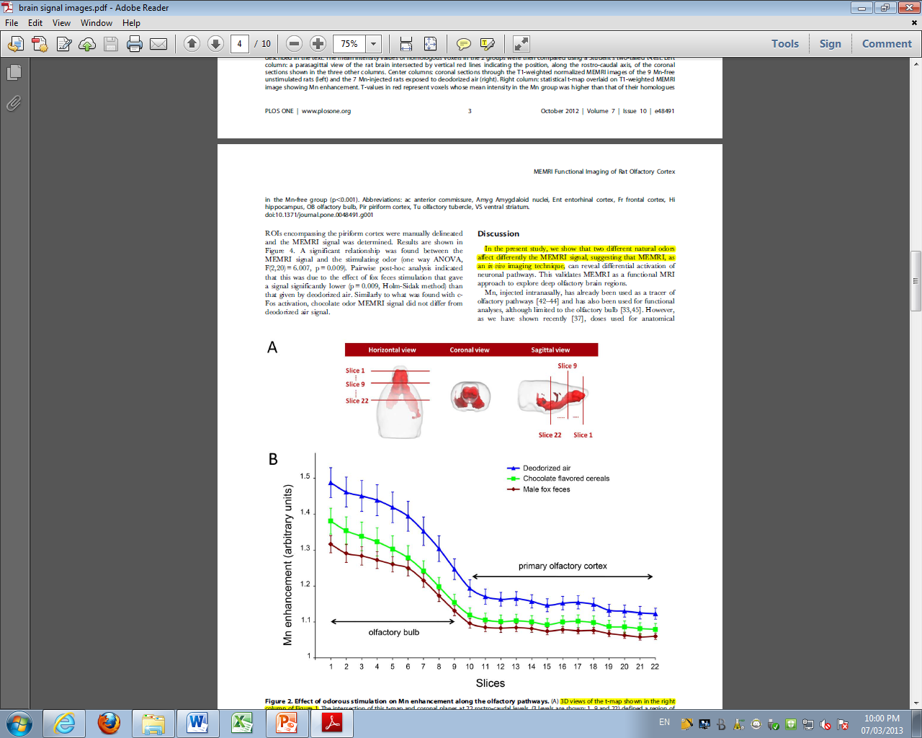
Brain signal images
(confirmed by c-Fos immunohistochemistry)
MEMRI activation maps showed Mn enhancement all along the primary olfactory cortex.

Slide 30
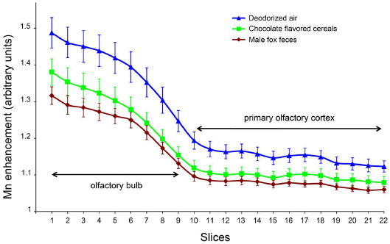
Brain signal images
Odour stimulants were used to stimulate conscious rats previously treated by intranasal instillation of manganese (Mn)
Differents natural odour activate differently the central olfactory pathways in the piriform cortex

Slide 31
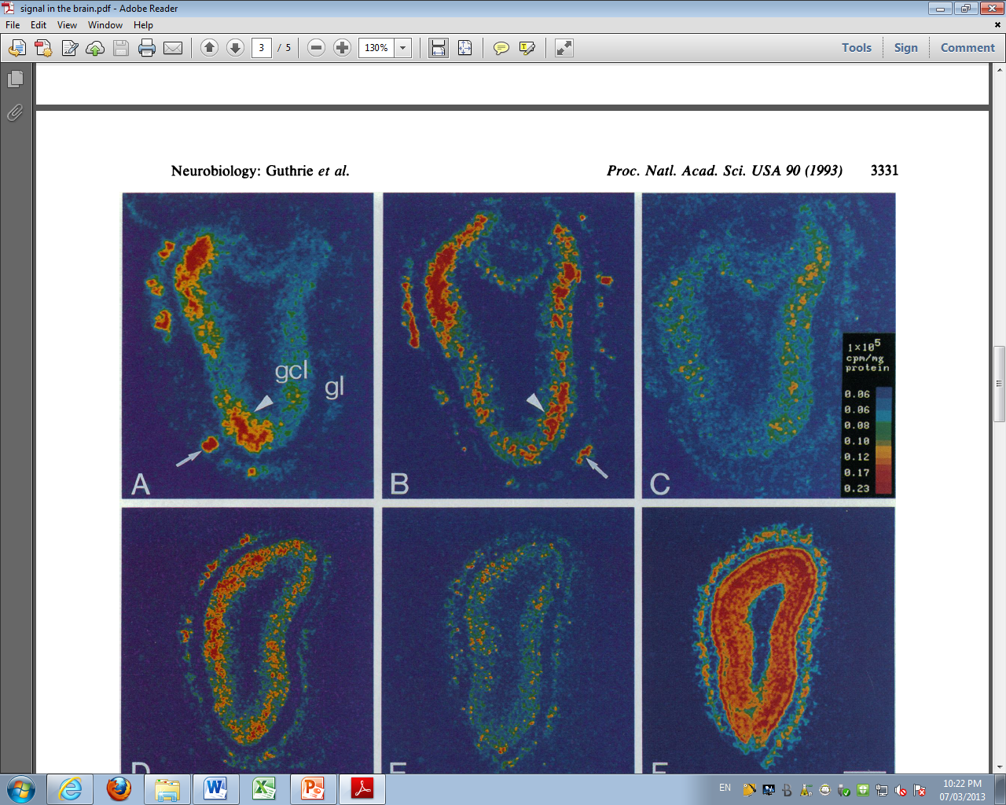
Brain signal images
(35S-labeled c-fos cRNA
(A) or for [14C]dGlc
autoradiography)
Pseudocolor images of film autoradiograms of olfactory bulb of rats exposed to
peppermint (A)
isoamyl acetate (B)
clean air (C)

Slide 32
State of the art
Examine the state of the art of instrumental sensing currently used for the detection of odours
Why ? : Air pollution mainly due to industrial and commercial activities; They introduce an enormous and various amount of chemicals into the ambient air.

Slide 33
State of the art
Based on Gas Chromatography coupled with Mass Spectrometry (GC/MS) widely used to analyse air quality
They are called Electronic Noses (E-Noses)
detection threshold = equivalent to 1 m³ n-butanol (reference gas)
The discovery of materials with chemo-electronic properties has provided the opportunity for the development of artificial olfactory instruments mimicking the biological system

Slide 34
State of the art
Properties : must themselves be odourless, undergo minimal physical or chemical reactions with the air sample.
Name:
Polytetrafluoroethylene <-> Teflon
Polyvinylfluoride <-> Tedlar
polyterephtalic ester <-> Nalophan
Sampling device:
Canisters – Odourmapper - Aromascan

Slide 35
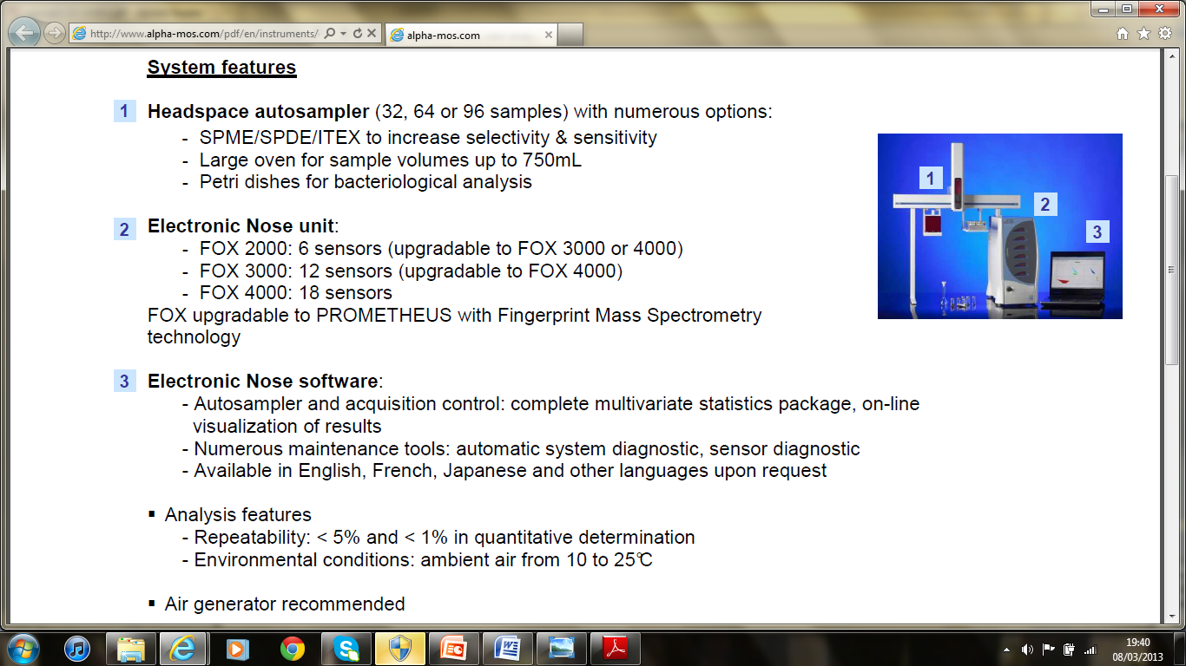
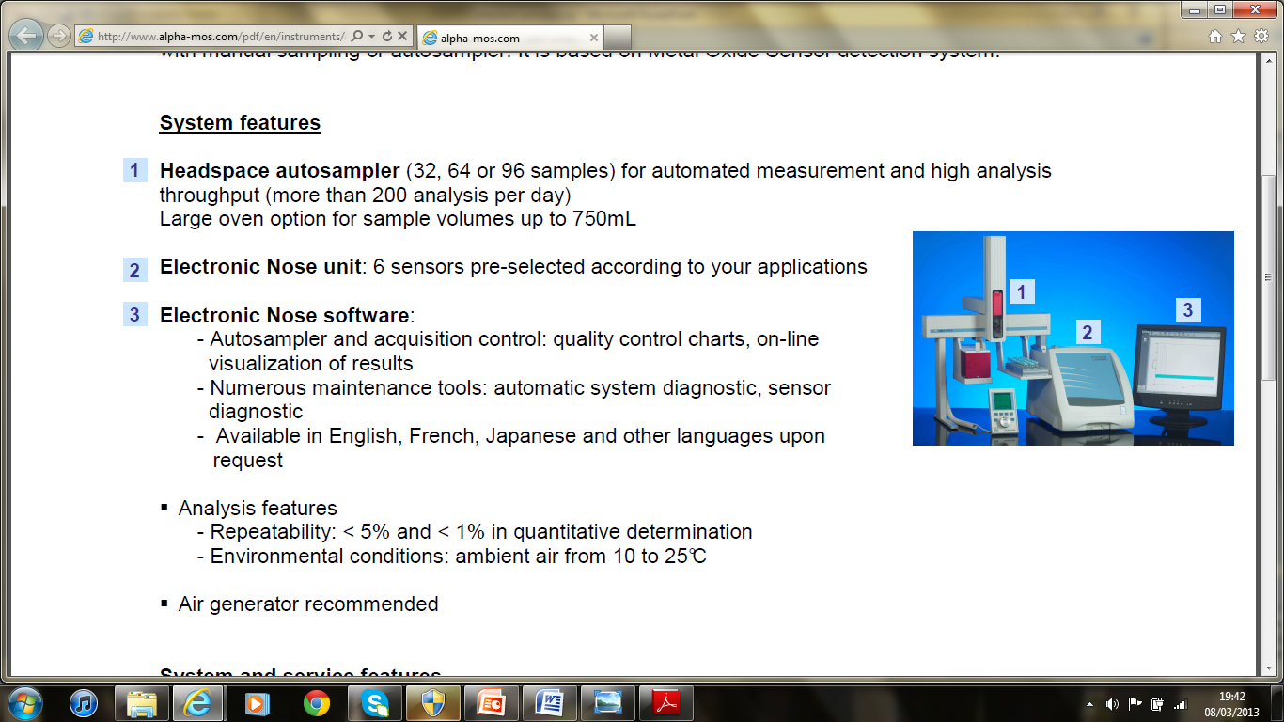
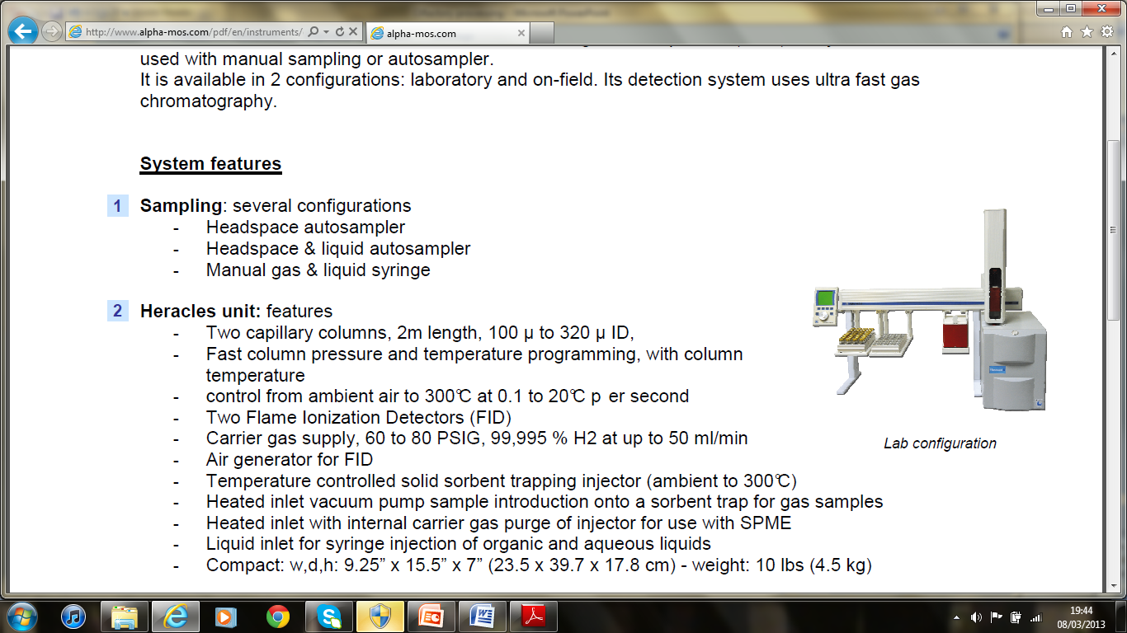
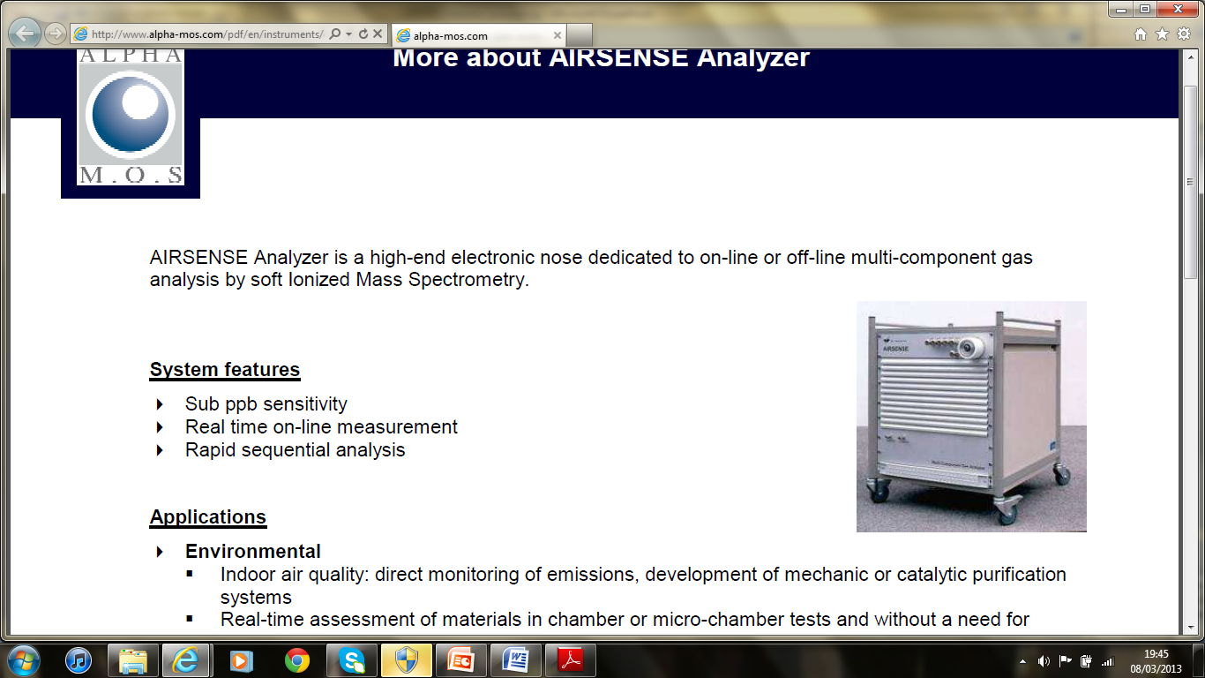
State of the art
GEMINI
FOX
HERACLES
AIRSENSE

Slide 36
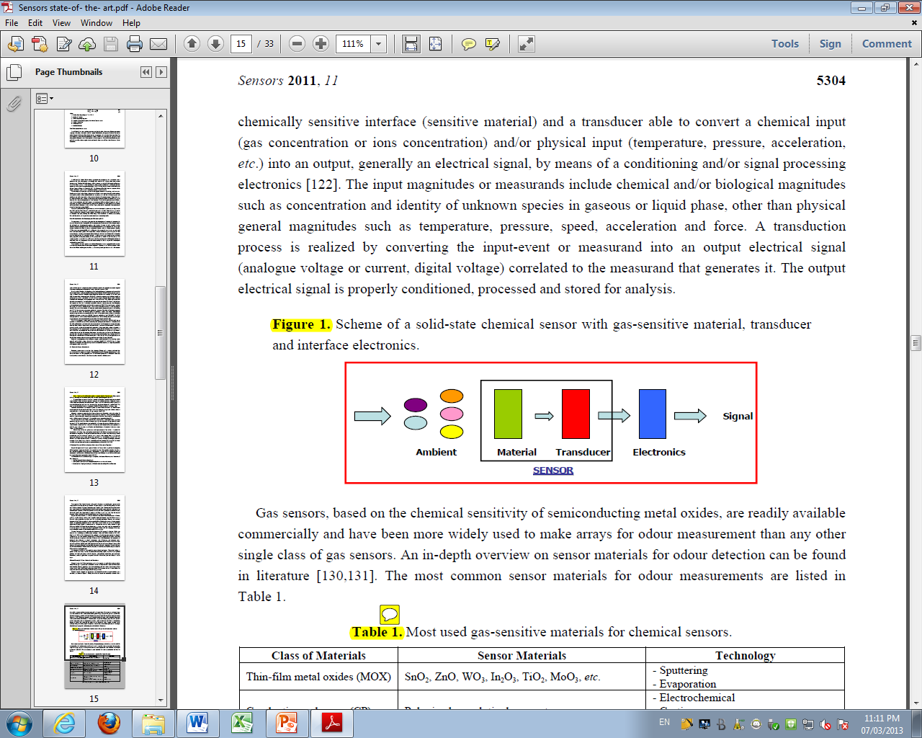
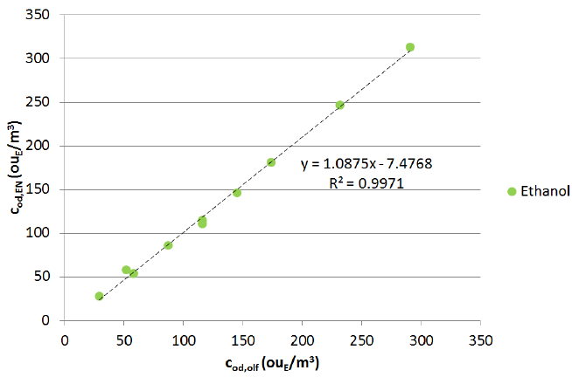
State of the art
Principle
Laboratory tests
Estimated Vs Real odour concentration of the ethanol sample

Slide 37
Conclusion
The sense of smell is the one that informs us about the volatile molecules in our environment. with a complex system ranging from the receptors to the puriform cortex, it manages not only smells signaling but also emotional behavior associated with it. It’s possible to analyze the afferent activity, as demonstrated in the main article. Moreother, technology has developed E-nose outstanding performance, mimicking the olfactory system in order to monitor the ambient air pollution. One always learn from nature.

Slide 38

Questions

